Slide 1


CF-HomeSpIT
The CF Home Sputum-Induction Trial to evaluate home sputum-induction and early morning saliva sampling in children with Cystic Fibrosis
K. Ronchetti , J.-D. Tame , L. Thia , A. Aseeri , R. Weiser , E. Mahenthiralingam , J.T. Forton.
CF-SpIT Study Group
The Children's Hospital for Wales, Cardiff, United Kingdom
Cardiff University, School of Biosciences, Cardiff, United Kingdom,
NIHR Portfolio ID – 54158. ISRCTN86523335

Slide 2
New Challenges
Sputum volume and pathogen density are reduced in patients on HEMT,
BUT Pathogens are not eradicated
Highly sensitive PCR technologies means we need to redefine what actually constitutes an infection
Two Questions
How best to sample the airway ?
How best to analyse those samples ?

Slide 3
CF-SpIT
Annual
assessment
Acute
exacerbation
Bronchoscopy
indicated
How to sample
How to analyse
Cough
swab
Induced
sputum
Bronchoscopy
6 lobes
Bank of samples
CF pathogens detected by
conventional microbiology culture
CF pathogens detected
Culture independent microbiology
Microbiome evolution in children with Cystic Fibrosis
Clinical determinants of accelerated evolution
Ronchetti K. et al (2018)
The CF‐Sputum Induction Trial (CF‐SpIT) to assess lower airway bacterial sampling in young children with cystic fibrosis: a prospective internally controlled interventional trial. Lancet Respir Med. 2018 Jun;6(6):461‐71

Slide 4

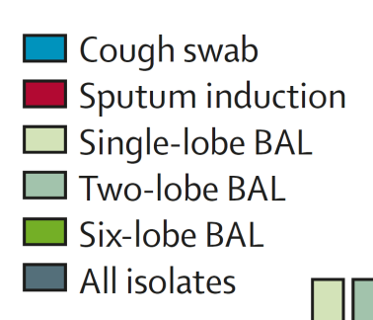
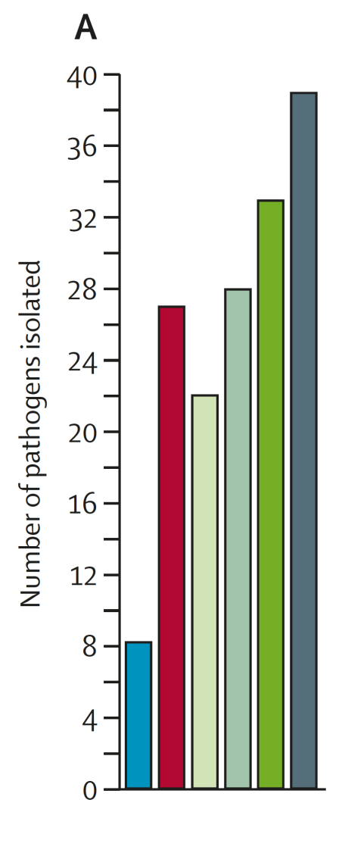
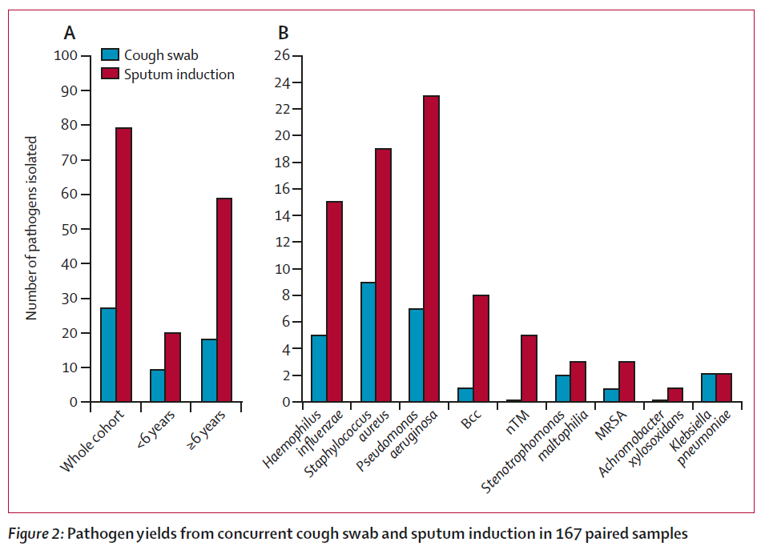
Sputum induction v cough swab
Sputum induction v BAL ( 1 lobe, 2 lobe and 6 lobe)
3 times as many pathogens
Equivalent to 2 lobe BAL
Lancet Respir Med. 2018 Jun;6(6):461‐71

Slide 5
CF SpIT: 30 patients
Paired sputum induction and 6 lobe BAL
Weiser R. et al (2022) The lung microbiota in children with cystic fibrosis captured by induced sputum sampling. J Cyst Fibros. 2022 Nov;21(6):1006-1012.
close
Examples of clear concordance between samples from a single patient
Act as biological replicates
Confidence in sampling and processing methodology
Confidence that a genuine biological signal is being captured
Sputum induction captures a meaningful representation of the lower airway microbiota in 80% of cases

Slide 6

Sputum induction can capture lower airway pathogens and characterise lower airway microbiota
Spatial microbiology of the airway is complex and difficult to describe with any single sample

Slide 7

Time consuming in clinic
Home sampling ?
Difficult to produce a sample
Patient Training ?

Slide 8



CF-HomeSpIT
The CF Home Sputum-Induction Trial to evaluate home sputum-induction and early morning saliva sampling in children with Cystic Fibrosis
K. Ronchetti , J.-D. Tame , L. Thia , A. Aseeri , R. Weiser , E. Mahenthiralingam , J.T. Forton , CF-SpIT Study Group
NIHR Portfolio ID – 54158. ISRCTN86523335
Non-blinded prospective internally-controlled interventional trial comparing home sampling to matched same day clinic sampling
Early morning saliva Home sputum induction Clinic cough swab Clinic saliva Clinic sputum induction
NHS Clinical Microbiology
Primary outcome
Microbiome Research
Evaluation
Inflammation

Slide 9
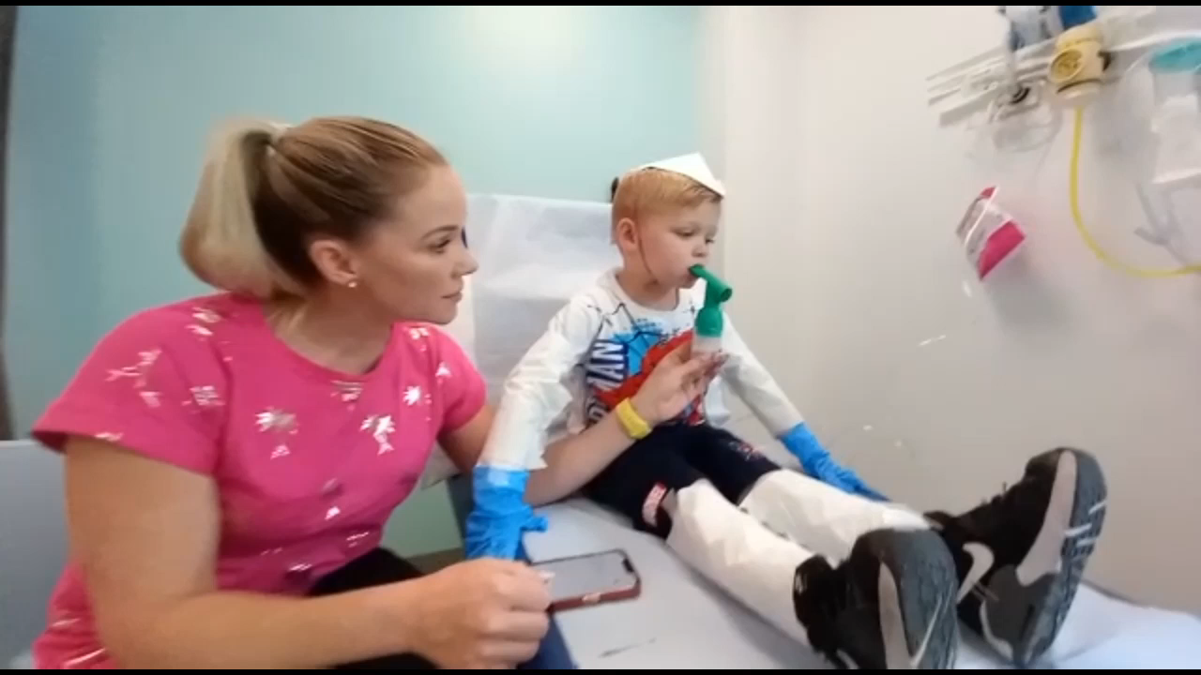
Sputum Induction - Hypertonic saline, exercise, PEP and cough clear

Slide 10
Cough clear
Easy cough clear
Oropharyngeal suction

Slide 11
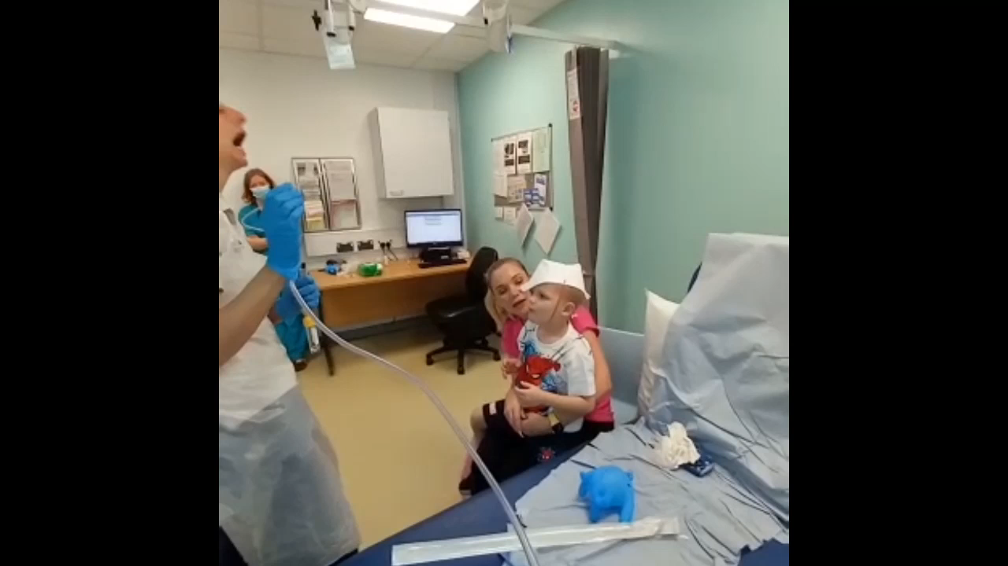
Oropharyngeal suction

Slide 12
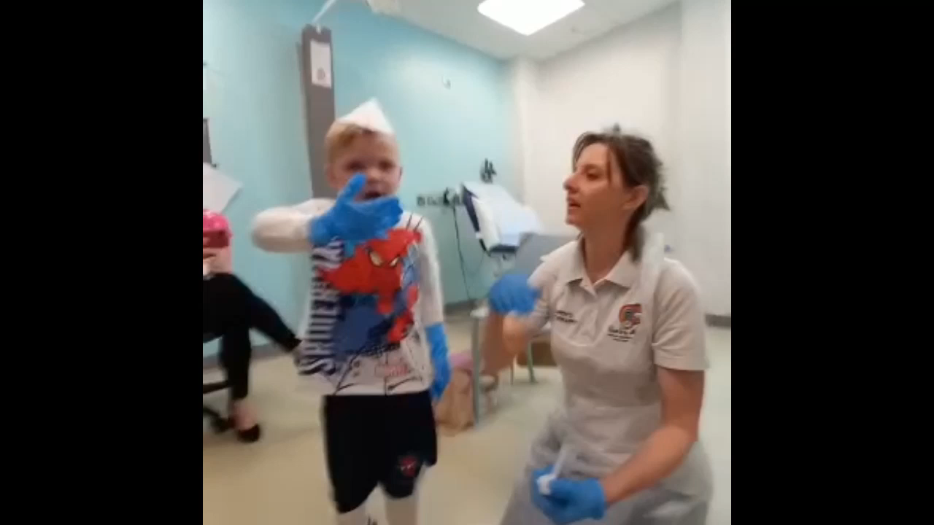

Slide 13
Early morning saliva
Home sputum induction

Slide 14
CF-HomeSpIT
Interim Results for first 34 recruited patients
32/34 (94%) patients remembered to perform home sampling on the day of clinic

Slide 15
CF-HomeSpIT
Interim Results for first 32 patients
10/32 (31%) patients from all approaches taken together
11 pathogens were identified in total
5/32 (16%) cough swabs were pathogen positive

Slide 16
CF-HomeSpIT
Interim Results for first 32 recruited patients
\
10/11 (91%) pathogens were identified on home sampling combined with clinic cough swab (emSAL+hIS+cCS)
10/11 (91%) pathogens were identified on clinic sampling combined (cCS+cSAL+cIS)
\\\\\\\\\

Slide 17
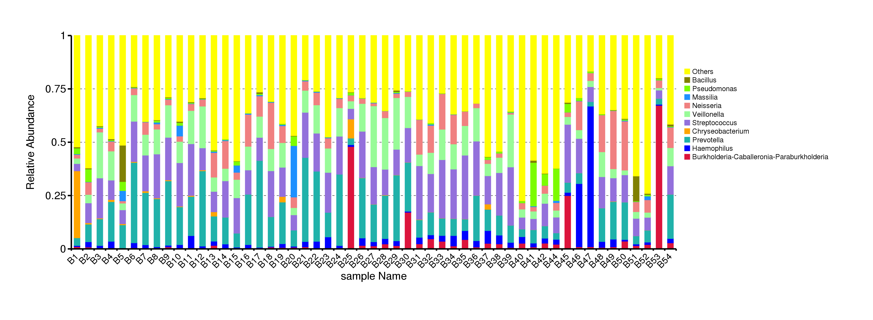
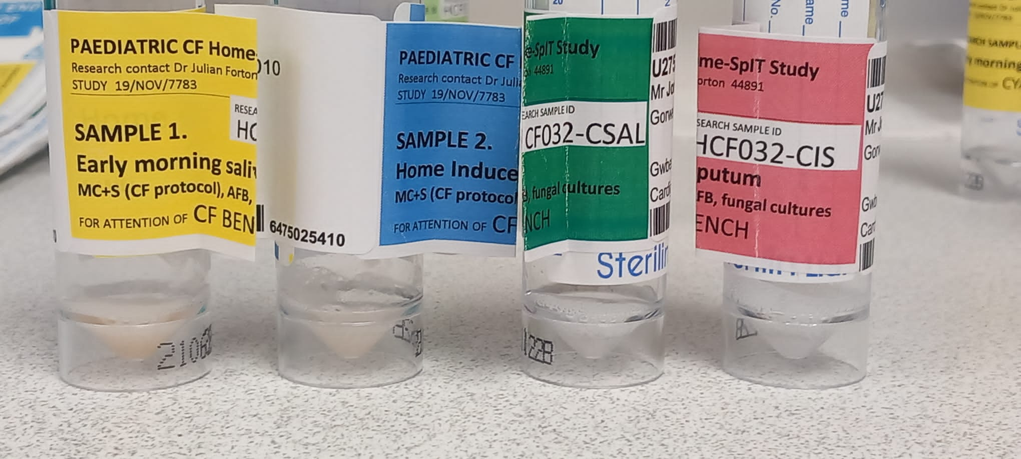
CF-HomeSpIT
Interim Results for microbiota
Patient 14
emSAL hIS cCS cSAL cIS

Slide 18
CF-HomeSpIT
No Conclusions yet – interim analysis
Home-sampling is possible, with comparable pathogen yield compared to supervised clinic sampling.
Combining approaches to sampling increases pathogen yield
Early morning saliva with trained cough clear is a novel, quick, practical approach to sampling that warrants further evaluation
Home sampling may also benefit adult populations who now produce less sputum and in whom new approaches to pathogen surveillance need to be explored

Slide 19
Realistic expectations

Slide 20
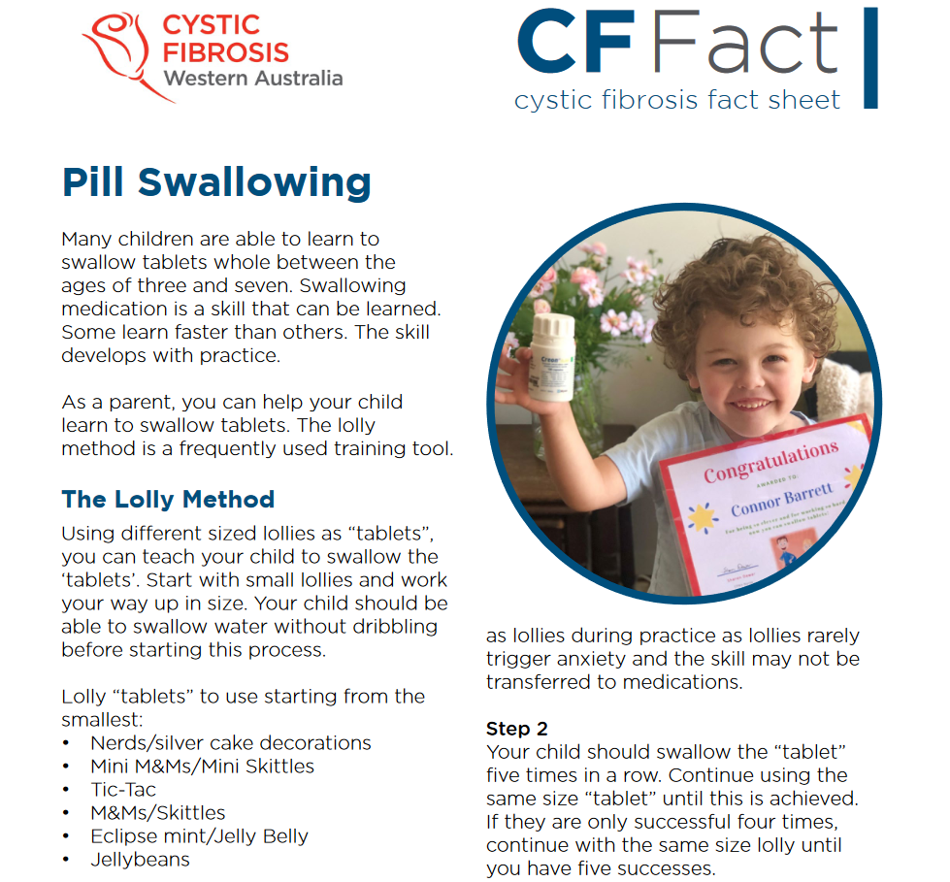
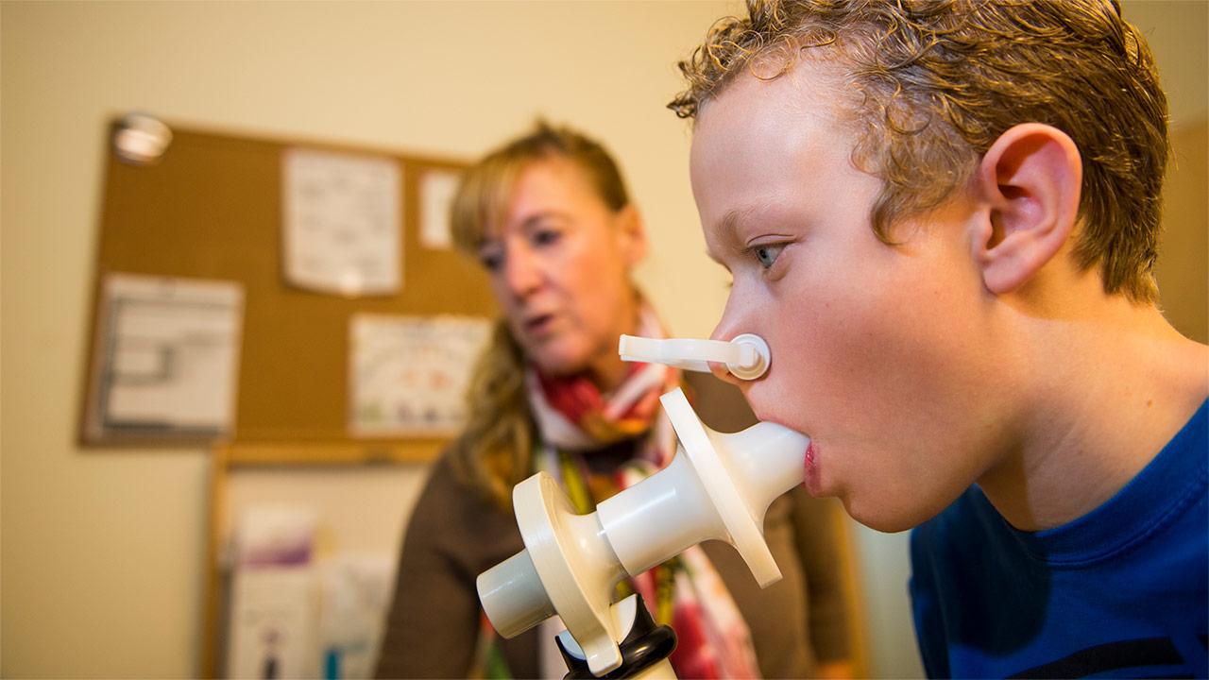
CF Community
Expertise in Patient Training
Children’s Hospital Colorado

Slide 21
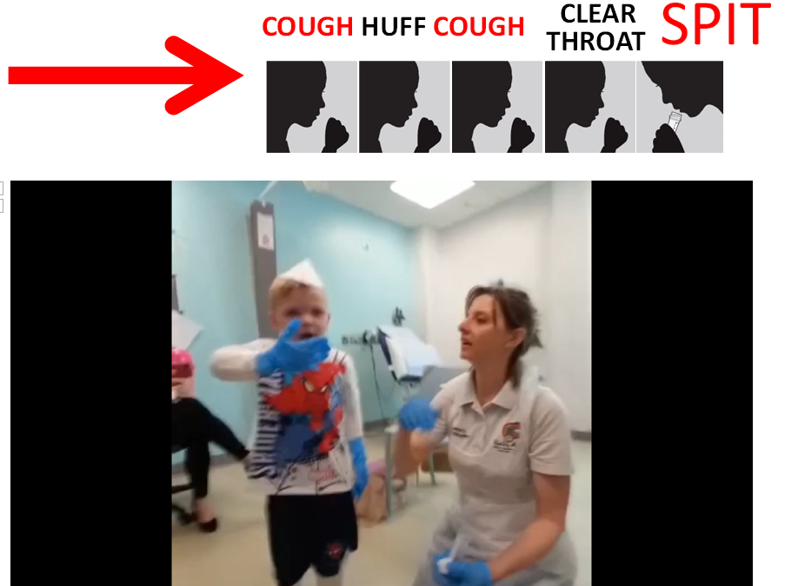
Training
Sputum induction is worth it

Slide 22





CFSpIT
The Children’s Hospital for Wales
Dr Julian T. Forton
Kath Ronchetti Research Physiotherapist
Hannah Morgan CF Physiotherapist
Jodee Tame CF Physiotherapist
Dr Juliette Oakley Clinical Research Fellow MD
Department of Biosciences, Cardiff University
Prof Eshwar Mahenthiralingham
Dr Rebecca Weiser
Abdullah Aseeri
Department of Microbiology, UHW, Cardiff
Dr Rishi Dhillon

